Slide 1
Memory-Efficient Optimization of Gyrokinetic Particle-to-Grid Interpolation for Multicore Processors
Kamesh Madduri, Samuel Williams, Stephane Ethier,
Leonid Oliker, John Shalf, Erich Strohmaier, Katherine Yelick
Lawrence Berkeley National Laboratory (LBNL)
National Energy Research Scientific Computing Center (NERSC)
Princeton Plasma Physics Laboratory (PPPL)
SWWilliams@lbl.gov

Slide 2
Outline
Gyrokinetic Toroidal Code
Challenges for efficient PIC simulations
Solutions for multicore
Results
Summary and Discussion

Slide 3
Gyrokinetic Toroidal Code

Slide 4
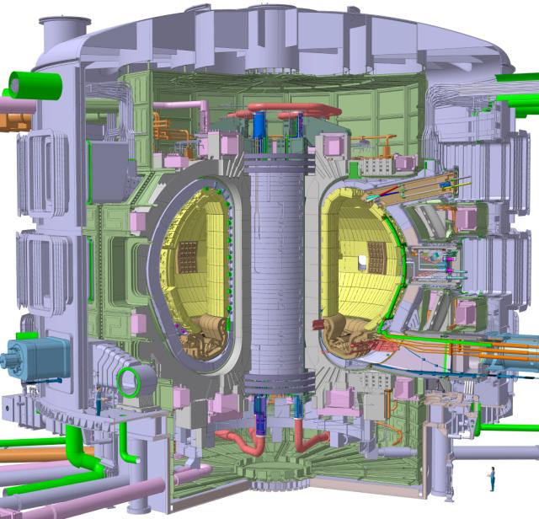
Gyrokinetic Toroidal Simulations
Simulate the particle-particle interactions of a charged plasma
in a Tokamak fusion reactor
With millions of particles per processor, the naïve N² method is totally intractable.
Solution is to use a particle-in-cell (PIC) method

Slide 5
Particle-in-Cell Methods
Particle-in-cell (or particle-mesh) methods simulate particle-particle interactions in O(N) time by examining the field rather than individual forces.
Typically involves iterating on four steps:
From individual particles, determine the spatial distribution of charge
From the distribution of charge, determine the electromagnetic potential
From the potential, determine the force on each particle
Given force, move the particle.
This requires creation of two auxiliary meshes (arrays):
the spatial distribution of charge density
the spatial distribution of electromagnetic potential
In the sequential world, the sizes of the particle arrays are an order of magnitude larger than the grids
Particle-in-cell (or particle-mesh) methods simulate particle-particle interactions in O(N) time by examining the field rather than individual forces.
Typically involves iterating on four steps:
Scatter Charge:
Poisson Solve:
Gather:
Push:
determine ρ
²φ ~ ρ
φ accelerates particles

Slide 6
Challenges:
Technology
PIC
GTC
Memory-level parallelism
Locality

Slide 7
Technology
In the past DRAM capacity per core grew exponentially.
In the future, DRAM costs will dominate the cost & power of extreme scale machines
As such, DRAM per socket will remain constant or grow slower than cores
Applications must be re-optimized for a fixed DRAM budget
= sustained Flop/s per byte of DRAM capacity
Algorithms/optimizations whose DRAM capacity requirements scale linearly with the number of cores are unacceptable

Slide 8
PIC Challenges
Nominally, push is embarrassingly parallel, and the technologies for solving PDEs on structured grids are well developed.
Unfortunately efficient HW/SW support for gather/scatter operations is still a developing area of research
(single thread/multicore/multinode)
Although particles and grid points appear linearly in memory,
1
2
3
4
5
0
1
2
3
4
5
6
7
8
9
10
11
12
13
14
15
16
17
18
19
20
21
22
23
24
25
26
27
28
29
30
31
32
33
34
35

Slide 9
PIC Challenges
Nominally, push is embarrassingly parallel, and the technologies for solving PDEs on structured grids are well developed.
Unfortunately efficient HW/SW support for gather/scatter operations is still a developing area of research
(single thread/multicore/multinode)
When the particles’ spatial coordinates are mapped to the grid,
there is no correlation
1
5
3
4
2

Slide 10
PIC Challenges
Nominally, push is embarrassingly parallel, and the technologies for solving PDEs on structured grids are well developed.
Unfortunately efficient HW/SW support for gather/scatter operations is still a developing area of research
(single thread/multicore/multinode)
Thus particles will update random locations in the grid,
or conversely, grid points are updated by random particles
1
5
3
4
2

Slide 11
PIC Challenges
Nominally, push is embarrassingly parallel, and the technologies for solving PDEs on structured grids are well developed.
Unfortunately efficient HW/SW support for gather/scatter operations is still a developing area of research
(single thread/multicore/multinode)
Moreover, the load-store nature of modern microprocessors demands the operations be serialized (load-increment-store)
1
5
3
4
2

Slide 12
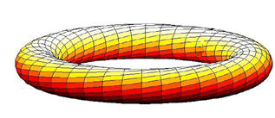
Sequential GTC Challenges
As if this weren’t enough, GTC further complicates matters as
the grid is a 3D torus
points in psi are spatially uniform
particles are non-circular rings (approximated by 4 points), and
Luckily rings only exist in a poloidal plane, but the radius of the ring can grow to ~6% of the poloidal radius.
2D “Poloidal Plane”
r
psi
3D Torus
a
d
b
c
zeta
mgrid = total number of points

Slide 13
3D Issues
Remember, GTC is a 3D code
As such, particles are sandwiched between two poloidal planes
and scatter their charge to as many 16 points in each plane

Slide 14
Multicore GTC Challenges (memory-level parallelism)
Although out-order processors reorder instructions to exploit instruction-level parallelism, they resolve the data dependencies in hardware.
If the sequence load₁, add₁, store₁, load₂, add₂, store₂ runs on one core, hardware can reorder it into :
load₁, load₂, add₁, add₂, store₁, store₂ assuming addresses 1 and 2 are different.
However, if sequences 1 and 2 run on different cores,
this benefit is lost and the programmer must manage the data dependency in software.

Slide 15
Multicore GTC Challenges (Data locality)
Multicore SMPs have complex memory hierarchies.
Although the caches are coherent, data migration between caches is slow and should be avoided.
Moreover each core has a limited cache size. If random access working set exceeds the size, performance will be diminished.
Given the random access nature (scatter/gather) of GTC, how do we partition the problem to mitigate these limitations?

Slide 16
Multicore Solutions

Slide 17
Focus: Charge Deposition
The charge deposition phase is the most complex as it requires solving the data dependency challenges in addition to the
data locality challenges found in the gather phase
As such, this talk will focus on optimizing charge deposition (scatter) phase for shared memory (threaded) multicore environments
In the MPI version of GTC, the torus is first partitioned in zeta (around the torus) into “poloidal planes” (1 per process)
Unfortunately the physics limits this decomposition to about 64-256 processes.
Currently, additional processes work collaboratively on each poloidal plane reducing together at the end of scatter.
We explore threading rather than MPI parallelization of each plane

Slide 18
Managing Data Locality (Particle Decomposition)
Throughout this work we use a simple 1D decomposition of the particle array:
Particles are initially sorted by their radial coordinate
0
1
2
3
4
5
6
7
8
9
10
11
12
13
14
15
16
17
18
19
20
21
22
23
24
25
26
27
28
29
30
31
thread 0
thread 1
thread 2
thread 3

Slide 19
Managing Data Locality (Grid Decomposition)
We explored four different strategies for managing data locality and total memory usage.
In all cases there is a shared grid.
It may be augmented with (private) per-thread copies
update thread’s copy of grid if possible, else update shared grid.
shared grid
partitioned grid
partitioned grid
(w/ghosts)
replicated grids
thread 0
thread 0
thread 0
thread 1
thread 1
thread 1
thread 2
thread 2
thread 2
thread 3
thread 3
thread 3
no replication
full overlap
O(1) replicas
no overlap
O(1) replicas
overlap by rmax/16
O(P) replicas
no overlap

Slide 20
Example #1
Consider an initial distribution of particles on the shared grid.
As the grid is a single shared data structure, all updates require some form of synchronization
21
29
15
3
20
26
13
27
25
14
2
9
10
1
16
19
8
31
6
4
24
7
0
28
23
17
5
11
12
18
22
30
20

Slide 21
Example #2
When using the partitioned grid, we see that some accesses go to the private partitions, but others go to the shared grid (where they will need some form of synchronization)
29
20
13
2
14
10
25
1
19
6
8
0
28
11
23
12
18
30
21
15
3
26
27
9
16
24
31
4
7
17
5
22

Slide 22
Managing Data Hazards (Synchronization)
We explored five different synchronization strategies:
coarse lock all r & zeta for a given psi (2 rings)
medium lock all zeta for a given r & psi (2 grid points)
fine lock one grid point at a time
atomic 64b FP atomic increment via CAS
(required some assembly/intrinsics)
none one barrier at the end of the scatter phase
Remember the coarser the lock
the more overhead is amortized
the less the available concurrency

Slide 23
Visualizing Locking Granularity
Coarse
Medium / Fine
0
0
0
note, medium locking locks the same point
in both sandwiching poloidal planes
where fine locks the point in one plane
at a time.

Slide 24
Locality × Synchronization
There are 20 combinations of grid decomposition and data synchronization.
However,
3 won’t guarantee correct results (lack of required synchronization)
4 are nonsensical (synchronization when none is required)
As such, only 15 needed to be implemented
synchronization
coarse
medium
fine
atomic
none
shared
✔
✔
✔
✔
incorrect
partitioned
✔
✔
✔
✔
incorrect
decomposition
partitioned
(w/ghosts)
✔
✔
✔
✔
incorrect
replicated
nonsensical
nonsensical
nonsensical
nonsensical
✔

Slide 25
Miscellaneous
In addition, we implemented a number of sequential optimizations including:
Structure-of-arrays data layout
explicit SIMDization (via intrinsics)
Data alignment
loop fusion
process pinning

Slide 26
Results

Slide 27
Experimental Setup
We examined charge deposition performance on three multicore SMPs:
Dual-socket, quad-core, hyperthreaded 2.66GHz Intel Nehalem
Dual-socket, octal-core, 8-way VMT 1.16GHz Sun Niagara2
Dual-socket, quad-core 2.3GHz Barcelona (in SC’09 paper)
Niagara is a proxy for the TLP of tomorrow’s manycore machines
Problems are based on:
grid size (mgrid) 32K, 151K, 600K, 2.4M
particles per grid point (micell) 2, 5, 10, 20, 50, 100
Generally, we examine the performance of the threaded variant as a function of optimization or problem size
Additionally, we compare against the conventional wisdom MPI version.

Slide 28
Performance as a function of grid decomposition and synchronization
Consider problem with 150K grid points and 5 particles/point
As locks become increasingly finer, the overhead of pthreads becomes an impediment, but Atomic operations reduce the overhead dramatically
Nehalem did very well with the partially overlapping decomposition
Performance is much better than MPI
Partitioned decomposition attained performance comparable to replication
Nehalem
Process
Pinning
SIMD
Niagara2
MPI
Performance (GFlop/s)
MPI
Shared
Partitioned
Partitioned
+ ghosts
Reduction
Shared
Partitioned
Partitioned
+ ghosts
Reduction

Slide 29
Memory Usage as a function of grid decomposition and synchronization
Although the threaded performance was comparable to either the MPI variant or the naïve replication approach, the memory usage was dramatically improved
~12x on Nehalem, and ~100x on Niagara
Nehalem
Niagara2

Slide 30
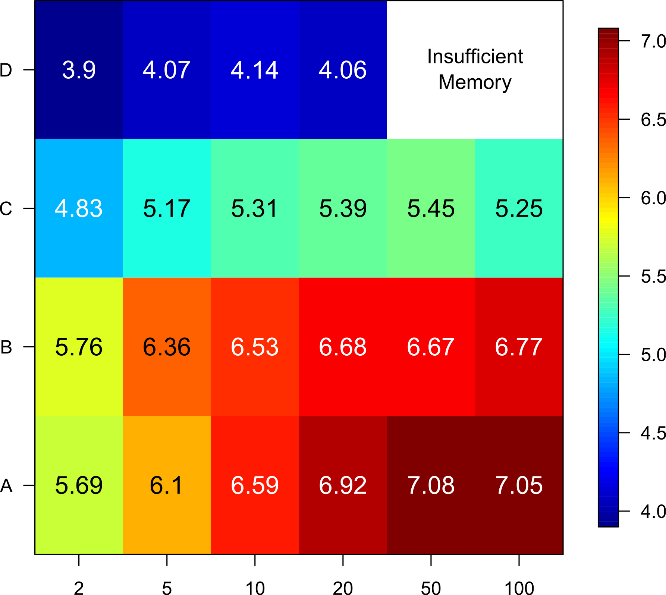
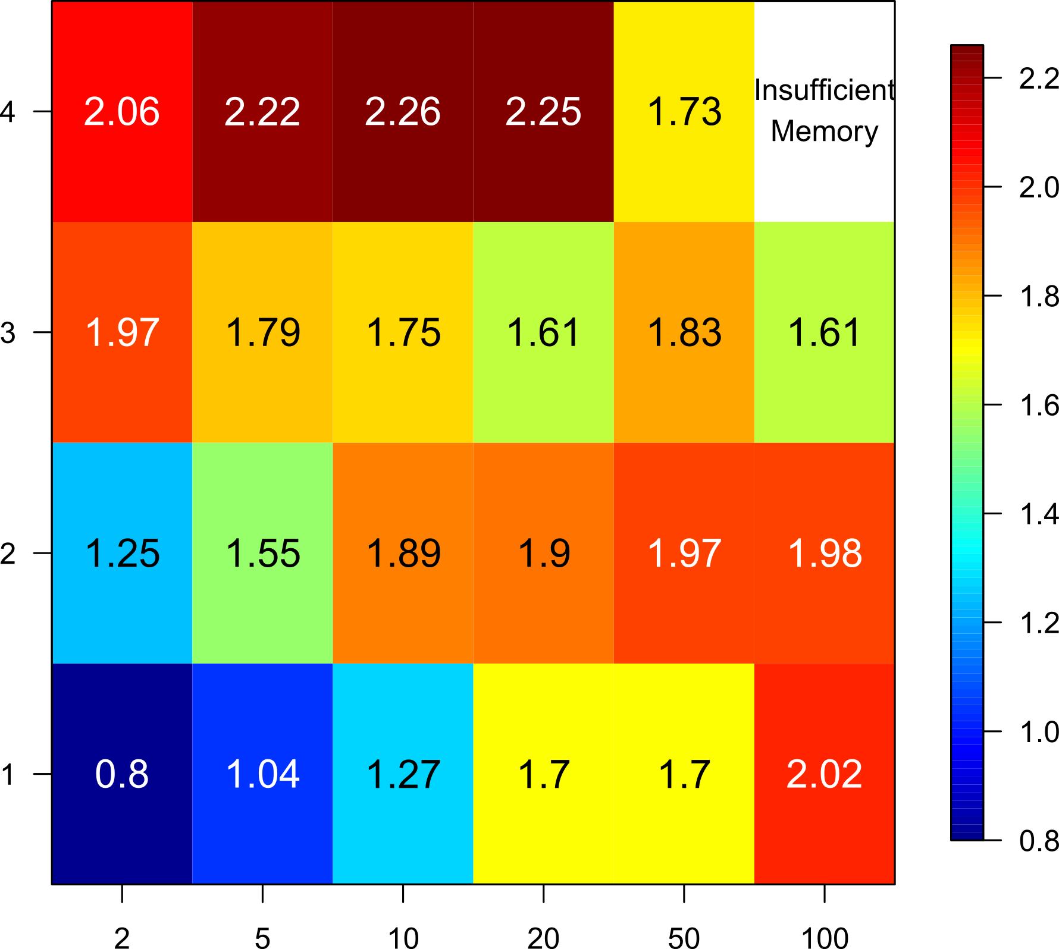
Performance as a function of problem configuration
For the memory-efficient implementations (i.e. no replication)
Performance generally increases with increasing density (higher locality)
Performance generally decreases with increasing grid size (larger working set)
On Niagara, problems need to be large enough to avoid contention among the 128 threads
Nehalem
Niagara2
2.4M
2.4M
600K
600K
Grid Size
Grid Size
151K
151K
32K
32K
Particles per Grid Point
Particles per Grid Point

Slide 31
Summary & Discussion

Slide 32
Summary
GTC (and PIC in general) exhibit a number of challenges to locality, parallelism, and synchronization.
Message passing implementations won’t deliver the efficiency
Managing data dependencies is a nightmare for shared memory
We’ve shown that threading the charge deposition kernel can deliver roughly twice the performance of the MPI implementation
Moreover, we’ve shown that we can be memory-efficient
(grid partitioning with synchronization) without sacrificing performance.

Slide 33
Further Reading
K. Madduri, S. Williams, S. Ethier, L. Oliker, J. Shalf, E. Strohmaier,
K. Yelick, "Memory-Efficient Optimization of Gyrokinetic Particle-to-Grid
Interpolation for Multicore Processors", Supercomputing (SC), 2009.

Slide 34
Acknowledgements
Research supported by DOE Office of Science under contract number DE-AC02-05CH11231
Research supported by Microsoft (Award #024263) and Intel (Award #024894) funding and by matching funding by U.C. Discovery (Award #DIG07-10227)

Slide 35
Questions?

