Slide 1
Lattice Boltzmann Hybrid Auto-Tuning on High-End Computational Platforms
Samuel Williams, Jonathan Carter,
Leonid Oliker, John Shalf, Katherine Yelick
Lawrence Berkeley National Laboratory (LBNL)
National Energy Research Scientific Computing Center (NERSC)
SWWilliams@lbl.gov

Slide 2
Outline
LBMHD
Auto-tuning LMBHD on Multicore SMPs
Hybrid MPI-Pthreads implementations
Distributed, Hybrid LBMHD Auto-tuning
pthread Results
OpenMP results
Summary

Slide 3
LBMHD

Slide 4
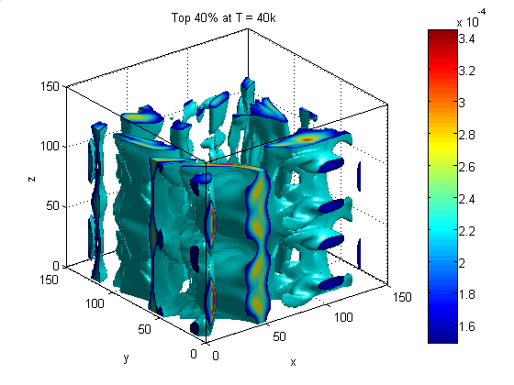
LBMHD
Lattice Boltzmann Magnetohydrodynamics (CFD+Maxwell’s Equations)
Plasma turbulence simulation via Lattice Boltzmann Method for simulating astrophysical phenomena and fusion devices
Three macroscopic quantities:
Density
Momentum (vector)
Magnetic Field (vector)
Two distributions:
momentum distribution (27 scalar components)
magnetic distribution (15 Cartesian vector components)
0
12
12
+Z
15
+Z
25
4
15
+Z
25
6
8
2
14
14
10
23
18
21
23
18
21
20
26
9
20
26
1
11
13
22
13
22
+Y
+Y
17
24
5
+Y
17
24
+X
7
3
16
16
19
+X
19
+X
macroscopic variables
momentum distribution
magnetic distribution

Slide 5
LBMHD
Code Structure
time evolution through a series of collision( ) and stream( ) functions
When parallelized, stream( ) should constitute 10% of the runtime.
collision( )’s Arithmetic Intensity:
Must read 73 doubles, and update 79 doubles per lattice update (1216 bytes)
Requires about 1300 floating point operations per lattice update
Just over 1.0 flops/byte (ideal architecture)
Suggests LBMHD is memory-bound on the XT4.
Structure-of-arrays layout (component’s are separated) ensures that cache capacity requirements are independent of problem size
However, TLB capacity requirement increases to >150 entries
periodic boundary conditions

Slide 6
Auto-tuning LBMHD on Multicore SMPs
Samuel Williams, Jonathan Carter, Leonid Oliker, John Shalf, Katherine Yelick, "Lattice Boltzmann Simulation Optimization on Leading Multicore Platforms", International Parallel & Distributed Processing Symposium (IPDPS), 2008.

Slide 7
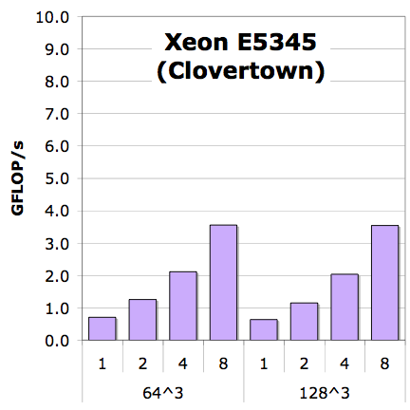
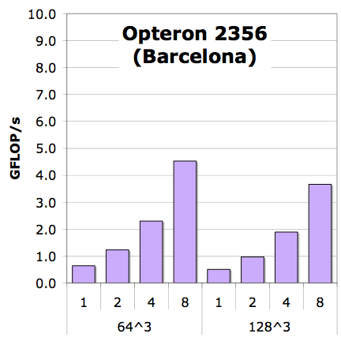
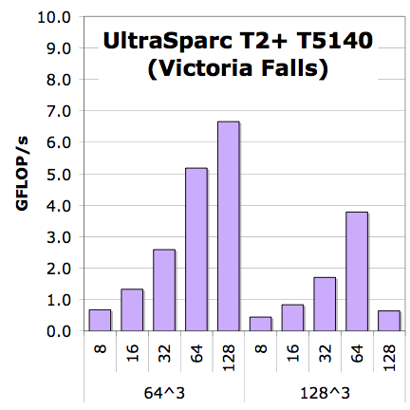
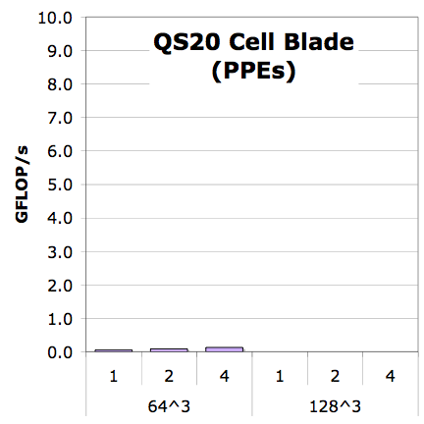
LBMHD Performance (reference implementation)
Generally, scalability looks good
Scalability is good
but is performance good?
Reference+NUMA
*collision() only
Notes:
PPE performance is abysmal

Slide 8
Lattice-Aware Padding
For a given lattice update, the requisite velocities can be mapped to a relatively narrow range of cache sets (lines).
As one streams through the grid, one cannot fully exploit the capacity of the cache as conflict misses evict entire lines.
In an structure-of-arrays format, pad each component such that when referenced with the relevant offsets (±x,±y,±z) they are uniformly distributed throughout the sets of the cache
Maximizes cache utilization and minimizes conflict misses.

Slide 9
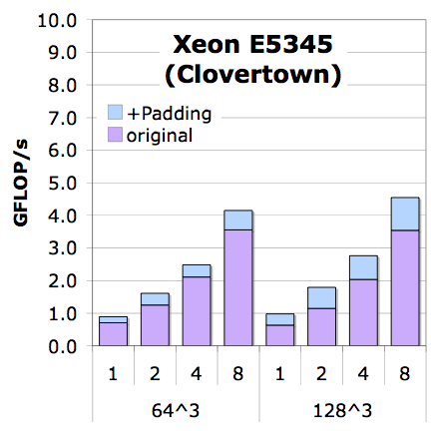
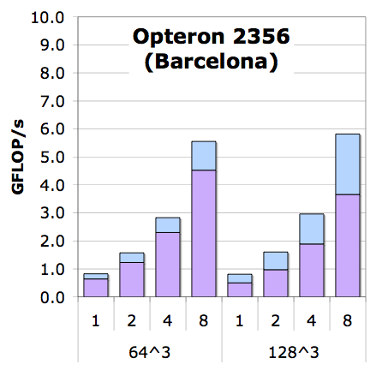
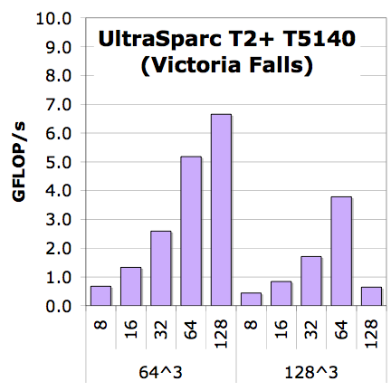
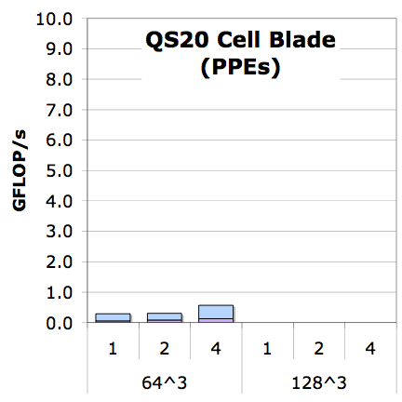
LBMHD Performance (lattice-aware array padding)
LBMHD touches >150 arrays.
Most caches have limited associativity
Conflict misses are likely
Apply heuristic to pad arrays
+Padding
Reference+NUMA

Slide 10
Vectorization
Two phases with a lattice method’s collision() operator:
reconstruction of macroscopic variables
updating discretized velocities
Normally this is done one point at a time.
Change to do a vector’s worth at a time (loop interchange + tuning)

Slide 11
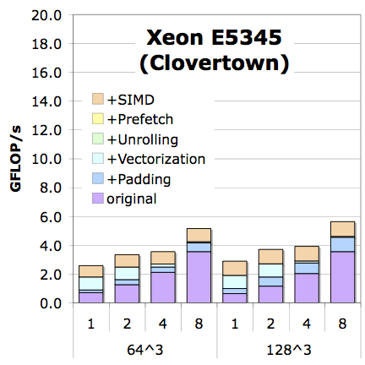
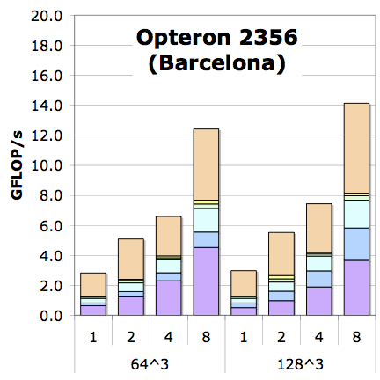
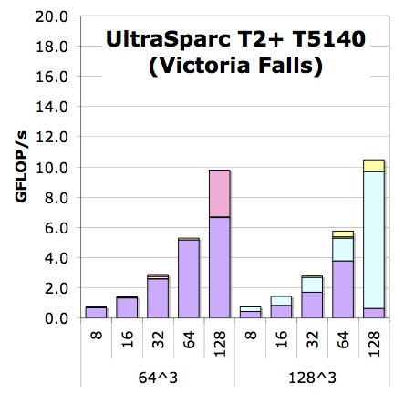
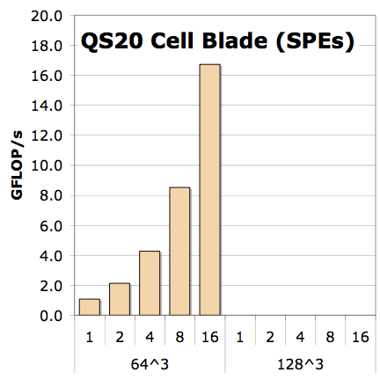
LBMHD Performance (architecture specific optimizations)
Add unrolling and reordering of inner loop
Additionally, it exploits SIMD where the compiler doesn’t
Include a SPE/Local Store optimized version
+small pages
+Explicit SIMDization
+SW Prefetching
+Unrolling
+Vectorization
+Padding
Reference+NUMA
*collision() only

Slide 12
LBMHD Performance (architecture specific optimizations)
Add unrolling and reordering of inner loop
Additionally, it exploits SIMD where the compiler doesn’t
Include a SPE/Local Store optimized version
1.6x
4x
3x
130x
+small pages
+Explicit SIMDization
+SW Prefetching
+Unrolling
+Vectorization
+Padding
Reference+NUMA
*collision() only

Slide 13
Limitations
Ignored MPP (distributed) world
Kept problem size fixed and cubical
When run with only 1 process per SMP, maximizing threads per process always looked best

Slide 14
Hybrid MPI+Pthreads Implementation

Slide 15
Flat MPI
In the flat MPI world, there is one process per core, and only one thread per process
All communication is through MPI

Slide 16
Hybrid MPI + Pthreads/OpenMP
As multicore processors already provide cache coherency for free, we can exploit it to reduce MPI overhead and traffic.
We examine using pthreads and OpenMP for threading (other possibilities exist)
For correctness in pthreads, we are required to include a intra-process (thread) barrier between function calls for correctness.
(we wrote our own)
Implicitly, OpenMP will barrier via the #pragma
We can choose any balance between processes/node and threads/process
(we explored powers of 2)
Initially, we did not assume a thread-safe MPI implementation (many versions return MPI_THREAD_SERIALIZED). As such, only thread 0 performs MPI calls

Slide 17
Distributed, Hybrid Auto-tuning

Slide 18
The Distributed Auto-tuning Problem
We believe that even for relatively large problems, auto-tuning only the local computation (e.g. IPDPS’08) will deliver sub-optimal MPI performance.
Want to explore MPI/Hybrid decomposition as well
We have a combinatoric explosion in the search space coupled with a large problem size (number of nodes)
at each concurrency:
for all aspect ratios
for all process/thread balances
for all thread grids
for all data structures
for all coding styles (reference, vectorized, vectorized+SIMDized)
for all prefetching
for all vector lengths
for all code unrollings/reorderings
benchmark

Slide 19
Our Approach
We employ a resource-efficient 3-stage greedy algorithm that successively prunes the search space:
Prune variant space
for all data structures
for all coding styles (reference, vectorized, vectorized+SIMDized)
for all prefetching
for all vector lengths
for all code unrollings/reorderings
benchmark
Prune parameter space
at limited concurrency (single node):
for all aspect ratios
for all process/thread balances
for all thread grids
benchmark
Production
at full concurrency:
for all process/thread balances
benchmark

Slide 20
Stage 1
In stage 1, we prune the code generation space.
We ran this as a 128³ problem with 4 threads.
As VL, unrolling, and
reordering may be problem
dependent, we only prune:
padding
coding style
prefetch distance
We observe that vectorization
with SIMDization, and a
prefetch distance of 64 Bytes
worked best

Slide 21
Stage 2
Hybrid Auto-tuning requires we mimic the SPMD environment
Suppose we wish to explore this color-coded optimization space.
In the serial world (or fully threaded nodes),
the tuning is easily run
However, in the MPI or hybrid world a problem arises as processes are not guaranteed to be synchronized.
As such, one process may execute some optimizations faster than others simply due to fortuitous scheduling with another processes’ trials
Solution: add an MPI_barrier() around each trial
(a configuration with 100’s of iterations)
one node
process0
process0
process1
process1
.
.
.
.
.
.
.
.
time

Slide 22
Stage 2 (continued)
We create a database of optimal VL/unrolling/DLP parameters for each thread/process balance, thread grid, and aspect ratio configuration

Slide 23
Stage 3
Given the data base from Stage 2,
we run few large problem using the best known parameters/thread grid for different thread/process balances.
We select the parameters based on minimizing
overall local time
collision( ) time
local stream( ) time

Slide 24
Results

Slide 25
XT4 Results (512³ problem on 512 cores)
Finally, we present the best data for progressively more aggressive auto-tuning efforts
Note each of the last 3 bars may have unique MPI decompositions as well as VL/unroll/DLP
Observe that for this large problem, auto-tuning flat MPI delivered significant boosts (2.5x)
However, expanding auto-tuning to include the domain decomposition and balance between threads and processes provided an extra 17%
2 processes with 2 threads was best

Slide 26
What about OpenMP ?

Slide 27
Conversion to OpenMP
Converting the auto-tuned pthreads implementation to OpenMP seems relatively straightforward (#pragma omp parallel for)
We modified code to be single source that supports:
Flat MPI
MPI+pthreads
MPI+OpenMP
However, it is imperative (especially on NUMA SMPs) to correctly utilize the available affinity mechanisms:
on XT, aprun has options to handle this
on linux clusters (like NERSC’s Carver), user must manage it:
#ifdef _OPENMP
#pragma omp parallel
{Affinity_Bind_Thread( MyFirstHWThread+omp_get_thread_num());}
#else
Affinity_Bind_Thread( MyFirstHWThread+Thread_Rank);
#endif
use both to be safe
Failure to miss these or other key pragmas can cut performance in half (or 90% in one particularly bad bug)

Slide 28
Optimization of Stream()
In addition, we further optimized the stream() routine along 3 axes:
messages could be blocked (24 velocities/direction/phase/process) or aggregated (1/direction/phase/process)
packing could be sequential (thread 0 does all the work) or
thread parallel (using pthreads/openMP)
MPI calls could be serialized (thread 0 does all the work) or
parallel (MPI_THREAD_MULTIPLE)
Of these eight combinations, we implemented 4:
aggregate, sequential packing, serialized MPI
blocked, sequential packing, serialized MPI
aggregate, parallel packing, serialized MPI (simplest openMP code)
blocked, parallel packing, parallel MPI (simplest pthread code)
Threaded MPI on Franklin requires using
threaded MPICH
calling using MPI_THREAD_MULTIPLE
setting MPICH_MAX_THREAD_SAFETY=multiple

Slide 29
Optimization of Stream()
In addition, we further optimized the stream() routine along 3 axes:
messages could be blocked (24 velocities/direction/phase/process) or aggregated (1/direction/phase/process)
packing could be sequential (thread 0 does all the work) or
thread parallel (using pthreads/openMP)
MPI calls could be serialized (thread 0 does all the work) or
parallel (MPI_THREAD_MULTIPLE)
Of these eight combinations, we implemented 4:
aggregate, sequential packing, serialized MPI
blocked, sequential packing, serialized MPI
aggregate, parallel packing, serialized MPI (simplest openMP code)
blocked, parallel packing, parallel MPI (simplest pthread code)
Threaded MPI on Franklin requires using
threaded MPICH
calling using MPI_THREAD_MULTIPLE
setting MPICH_MAX_THREAD_SAFETY=multiple

Slide 30
Optimization of Stream()
In addition, we further optimized the stream() routine along 3 axes:
messages could be blocked (24 velocities/direction/phase/process) or aggregated (1/direction/phase/process)
packing could be sequential (thread 0 does all the work) or
thread parallel (using pthreads/openMP)
MPI calls could be serialized (thread 0 does all the work) or
parallel (MPI_THREAD_MULTIPLE)
Of these eight combinations, we implemented 4:
aggregate, sequential packing, serialized MPI
blocked, sequential packing, serialized MPI
aggregate, parallel packing, serialized MPI (simplest openMP code)
blocked, parallel packing, parallel MPI (simplest pthread code)
Threaded MPI on Franklin requires using
threaded MPICH
calling using MPI_THREAD_MULTIPLE
setting MPICH_MAX_THREAD_SAFETY=multiple

Slide 31
MPI vs. MPI+Pthreads vs. MPI+OpenMP
When examining overall performance per core (512³ problem with cores), we see choice made relatively little difference
MPI+pthreads was slightly faster with 2thread/process
MPI+OpenMP was slightly faster with 4 threads/process
choice of best stream() optimization is dependent on thread concurrency and threading model
2 threads
per process
1 thread
per process
(flat MPI)
4 threads
per process
Up is good

Slide 32
MPI vs. MPI+Pthreads vs. MPI+OpenMP
When we look at collision time, we see that surprisingly 2 threads per process delivered slightly better performance for pthreads, but 4 threads per process was better for OpenMP.
Interestingly, threaded MPI resulted in slower compute time
2 threads
per process
1 thread
per process
(flat MPI)
4 threads
per process
Down is good

Slide 33
MPI vs. MPI+Pthreads vs. MPI+OpenMP
Variation in stream time was dramatic with 4 threads.
Here the blocked implementation was far faster.
Interestingly, pthreads was faster for 2 threads, openMP was faster for 4 threads.
Down is good
1 thread
per process
(flat MPI)
2 threads
per process
4 threads
per process

Slide 34
Summary & Discussion

Slide 35
Summary
Multicore cognizant auto-tuning dramatically improves (2.5x) flat MPI performance.
Tuning the domain decomposition and hybrid implementations yielded almost an additional 20% performance boost.
Although hybrid MPI promises improved performance through reduced communication, the observed benefit is thus far small.
Moreover, the performance difference among hybrid models is small.
Initial experiments on the XT5 (Hopper) and the Nehalem cluster (Carver) show similar results (little trickier to get good OpenMP performance on the linux cluster)
LBM’s probably will not make the case for hybrid programming models (purely concurrent with no need for collaborative behavior)

Slide 36
Acknowledgements
Research supported by DOE Office of Science under contract number DE-AC02-05CH11231
All XT4 simulations were performed on the XT4 (Franklin) at the National Energy Research Scientific Computing Center (NERSC)
George Vahala and his research group provided the original (FORTRAN) version of the LBMHD code.

Slide 37
Questions?

Slide 38
BACKUP SLIDES

Slide 39
Memory access patterns for Stencils
Laplacian, Divergence, and Gradient
Different reuse, Different #’s of read/write arrays

Slide 40
LBMHD Stencil
Simple example reading from 9 arrays and writing to 9 arrays
Actual LBMHD reads 73, writes 79 arrays

Slide 41
Arithmetic Intensity
O( log(N) )
O( 1 )
O( N )
A r i t h m e t i c I n t e n s i t y
SpMV, BLAS1,2
FFTs
Stencils (PDEs)
Dense Linear Algebra
(BLAS3)
Lattice Methods
Particle Methods
True Arithmetic Intensity (AI) ~ Total Flops / Total DRAM Bytes
Some HPC kernels have an arithmetic intensity that scales with problem size (increased temporal locality), but remains constant on others
Arithmetic intensity is ultimately limited by compulsory traffic
Arithmetic intensity is diminished by conflict or capacity misses.

Slide 42
Kernel Arithmetic Intensity and Architecture
For a given architecture, one may calculate its flop:byte ratio.
For a 2.3GHz Quad Core Opteron (like in the XT4),
1 SIMD add + 1 SIMD multiply per cycle per core
12.8GB/s of DRAM bandwidth
= 36.8 / 12.8 ~ 2.9 flops per byte
When a kernel’s arithmetic intensity is substantially
less than the architecture’s flop:byte ratio, transferring
data will take longer than computing on it
→ memory-bound
When a kernel’s arithmetic intensity is substantially greater than the architecture’s flop:byte ratio, computation will take longer than data transfers
→ compute-bound

