Slide 1
What’s in a Number?
(Implications of n=4)
Dan Martin
Applied Numerical Algorithms Group
Lawrence Berkeley National Laboratory

Slide 2

Joint work with…
Sam Kachuck (University of Michigan) (new baby!)
Joanna Millstein (MIT)
Brent Minchew (MIT)
Steph Cornford (Bristol)
Various AGU and EGU attendees and other glaciology-focused people…

Slide 3
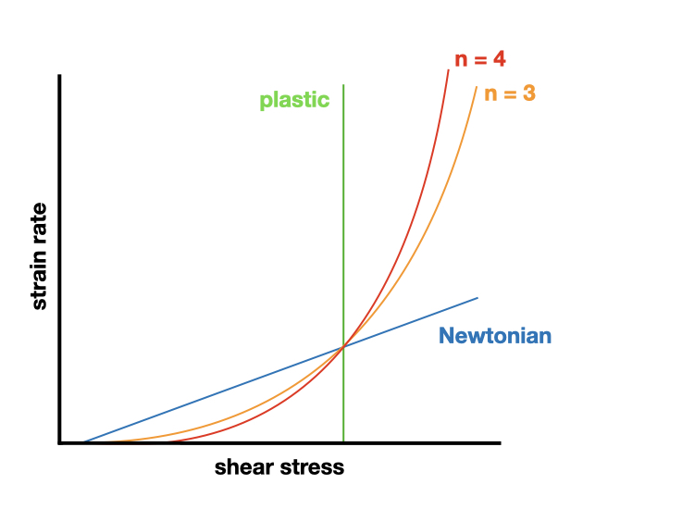
Ice and Glen’s Law…
non-Newtonian fluid with a shear-thinning rheology
ice viscosity given by a power-law relationship with
the strain-rate invariant:
ἐ = A𝜏ⁿ
  ἐ is the strain rate invariant
  A(T) is the rate factor
  𝜏 is the deviatoric stress
  n is the Glen’s law exponent
Usually n = 3
Recent work: n=4? (Millstein et al, 2022)
  Better matches Antarctic observations…

Slide 4
Ranganathan & Minchew (PNAS 2024)

Slide 5
So, n=4? (Is it time to panic?)
Most modeling, projections, etc are based on assumptions that n=3!
If n=4, what does that mean for our models? (and our projections up to this point?)
Try a simple numerical experiment…

Slide 6
Our experiment…
In most cases, models are initialized to match ice sheet observations of thickness and velocity.
An incorrect value of n implies that initialization/inversion process will attempt to match an n=3 configuration to these observations (in which the actual value is n=4).
To examine this impact, we do the following experiment:
  Set up (Spin up) an idealized ice sheet with n=4
  Perform our standard inversion process with n=3 to match the “observed” n=4 thickness and velocity fields.
  Force both n=3 and n=4 configurations in a similar way to determine the differences in response (if any) with our assumption of n=3.

Slide 7
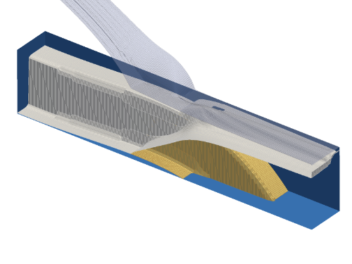
Idealized Experiment – MISMIP+
    Marine ice sheet in a channel with a retrograde bed section, designed to highlight ice shelf buttressing effects.
    Parameters like surface mass balance and basal friction chosen to place the steady-state grounding line on the retrograde slope due to the impact of ice shelf buttressing
    Forced by marine subsurface melting
      Reduced buttressing leads to acceleration, thinning, and GL retreat
MISMIP+ cross-section showing channel walls (brown) and steady-state ice upper- and lower-surfaces. (Asay-Davis, et al, 2015)

Slide 8
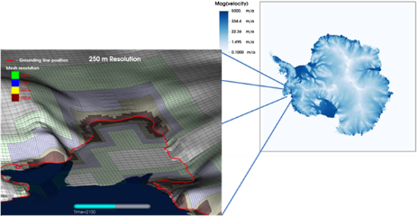
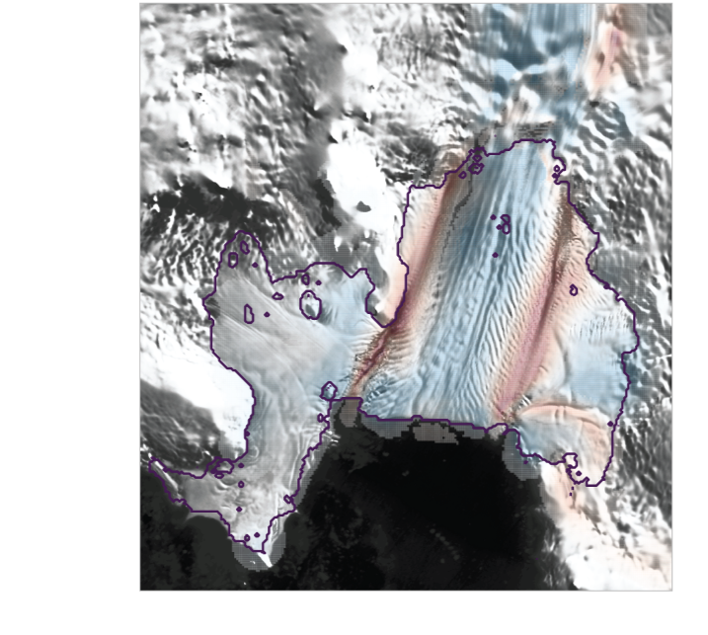


Numerical model
BISICLES ice sheet model
Adaptive mesh refinement (AMR) ice sheet model
which dynamically adds refined meshes where
needed to assure solution accuracy.
Variant of L1L2 (Schoof & Hindmarsh)
Inversion:
Tikhonov-penalized nonlinear CG
Infers a basal friction field along with
a viscosity multiplier $φ$ to represent the
impact of damage, rheology, etc.
$φ= {μ_{Observed}}/{μ_{n=3}}$
BISICLES-computed Antarctic ice velocity field. Inset shows adaptive meshing near the Pine Island Glacier grounding line.
Pine Island Glacier: BISICLES-computed $φ$superposed on satellite imagery.
Red = reduced viscosity
blue = increased viscosity

Slide 9
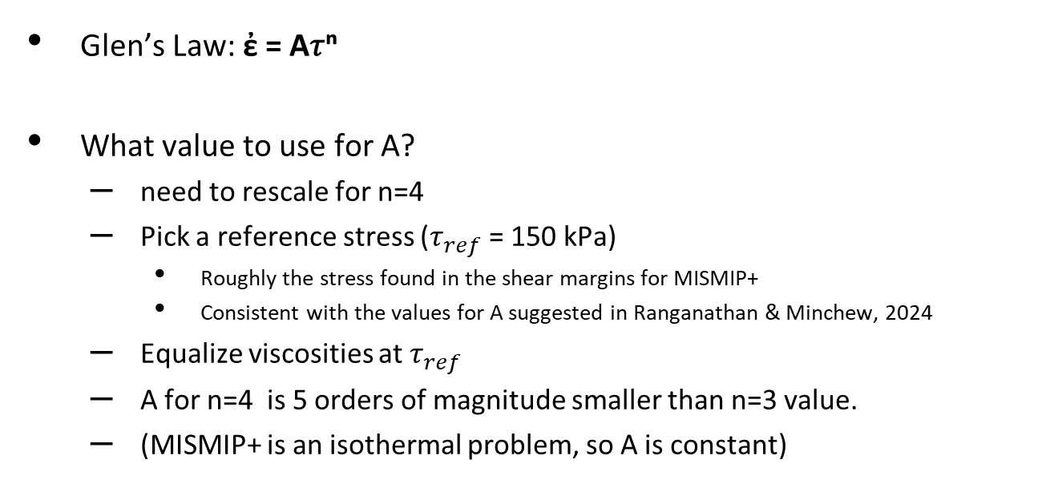
Difficulties, a.k.a. “considerations”…
Glen’s Law: ἐ = A𝜏ⁿ
What value to use for A?
  need to rescale for n=4
  Pick a reference stress ($τ_{ref}$= 150 kPa)
    Roughly the stress found in the shear margins for MISMIP+
    Consistent with the values for A suggested in Ranganathan & Minchew, 2024
  Equalize viscosities at $τ_{ref}$
  A for n=4 is 5 orders of magnitude smaller than n=3 value.
  (MISMIP+ is an isothermal problem, so A is constant)
150 kPa

Slide 10
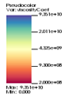

Buttressing is problematic…
Putting steady-state GL on retrograde slope relies on ice-shelf buttressing
But…
Shear layers – shear-thinning nature of Glen’s law concentrates shear into narrow low-viscosity shear margins.
n=4 – higher shear means even more shear-concentration –
  lower viscosities than n=3 case
  More stress concentration
  Reduced ability to transmit “buttressing” stresses in weaker ice…
Required greatly enhanced SMB (6x!) to create the steady state

Slide 11
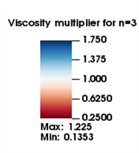
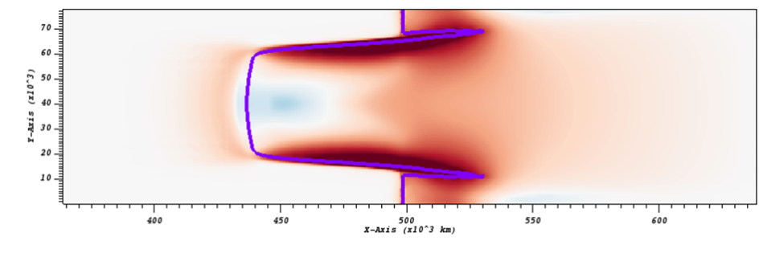
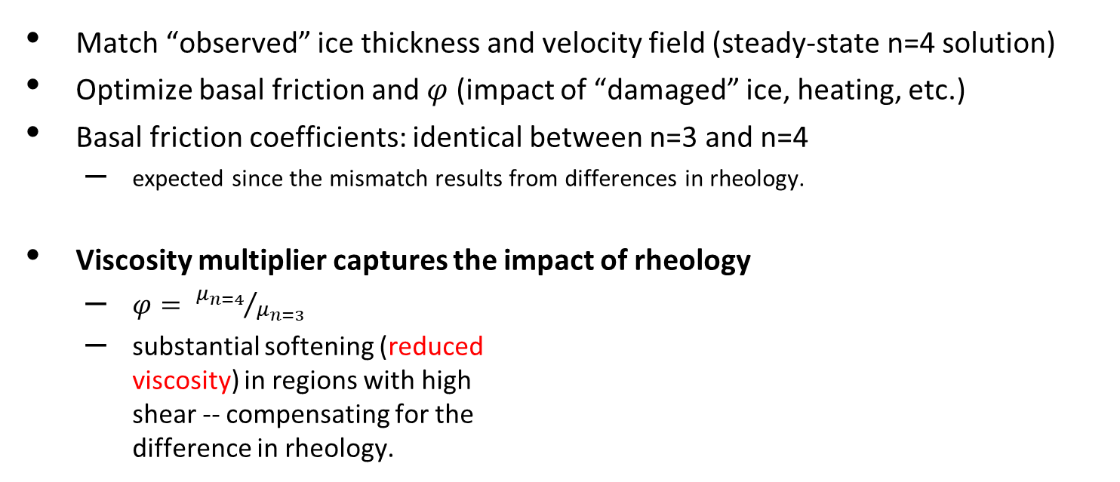
Inversion
Match “observed” ice thickness and velocity field (steady-state n=4 solution)
Optimize basal friction and $φ$ (impact of “damaged” ice, heating, etc.)
Basal friction coefficients: identical between n=3 and n=4
  expected since the mismatch results from differences in rheology.
Viscosity multiplier captures the impact of rheology
  $φ= {μ_{n=4}}/{μ_{n=3}}$
  substantial softening (reduced
  viscosity) in regions with high
  shear -- compensating for the
  difference in rheology.

Slide 12
Look familiar?

Slide 13
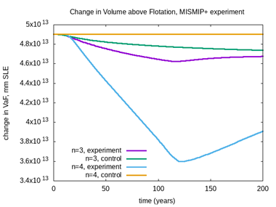
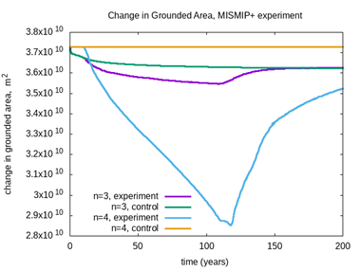
Evolution Experiment
Blue line: response for n=4 case
Green line: n=3 control
  (not quite steady-state, but close)
Purple line: response of n=3 case
Response of n=3 case greatly reduced relative to n=4
  probably due to weakened buttressing from the viscosity
  multiplier.

Slide 14
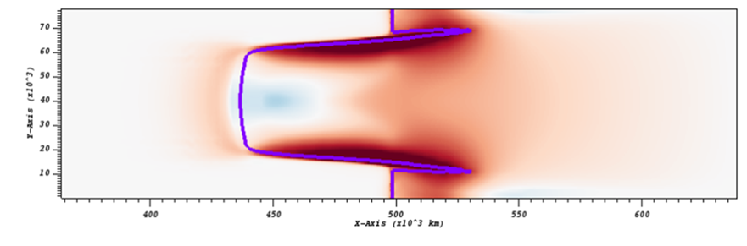
What can we say about this?
    Mismatched rheology appears in inversion
    results as prescribed softening (viscosity
    multiplier) to match n=4 observations.
    Some (Much?) of what is currently attributed to “damage” in inversions
    & initializations may be compensating for the incorrect value for n.
    Ice sheet models (including BISICLES) often keep these viscosity multipliers fixed in time, unless attempting to evolve a “damage” field.
    Implications for paleo and models which rely on spinups instead of inversions
    Dynamic response also affected – reduced buttressing impacts
      impact of ice shelf weakening & changes in buttressing appears to be greatly reduced.

Slide 15
Acknowledgements:
US Department of Energy Office of Science (ASCR/BER) SciDAC applications program (PISCEES, ProSPecT)
NERSC

Slide 16
Thank you!
Questions? DFMartin@lbl.gov

Slide 17
Extras

Slide 18
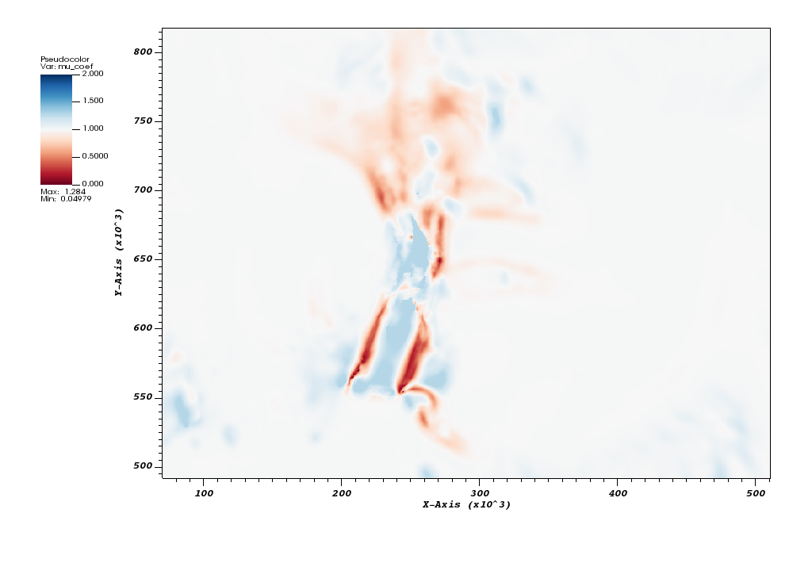
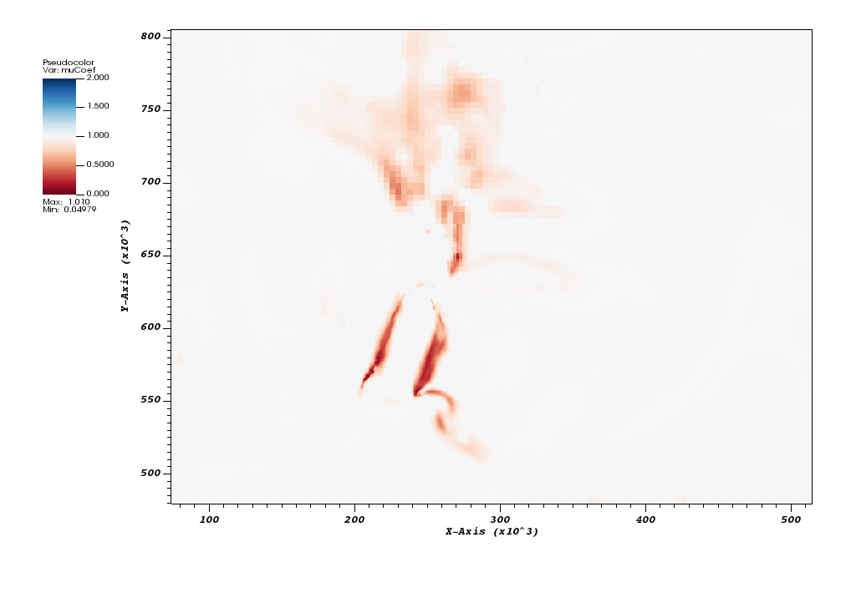
Amundsen Sea Inversion
n=3 n=4 (?)

