Slide 1
SRNoC: A Statically-Scheduled Circuit-Switched Superconducting Race Logic NoC
George Michelogiannakis, Darren Lyles,
Patricia Gonzalez-Guerrero, Meriam Bautista,
Dilip Vasudevan, Anastasiia Butko
mihelog@lbl.gov
Lawrence Berkeley National Laboratory, USA

Slide 2
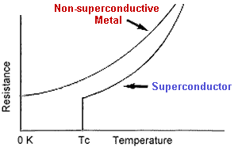
Background: Superconductivity
Resistance of mercury and other materials drops to near zero below ~4K
Gallardo et al, “Superconductivity observation in a (CuInTe 2 ) 1-x (NbTe) x alloy with x=0.5”
Notes:
Superconducting logic refers to a class of logic circuits or logic gates that use the unique properties of superconductors, including zero-resistance wires, ultrafast Josephson junction switches, and quantization of magnetic flux (fluxoid).
Note that absence of resistance (R = 0) leads to absence of voltage (V = 0) in a superconducting circuit in stationary state. Superconducting current flow corresponds not to electrical potentials difference (the voltage V = δφ) but to difference of superconducting order parameter phases δθ, accordingly.
. One of the most important Josephson junction parameters is its critical current, Ic. This is the maximum superconducting current capable of flowing through the junction. Josephson junction can be switched from superconducting to resistive state by increasing the current above Ic. Transition to resistive state allows to change magnetic flux in a superconducting loop, and hence to perform a digital logic operation.
JJs can be resistive or superconductive
One of the main advantages of cryogenic computing is the ability to eliminate static power. Eq. (1a) showsIleak significantly decreases at cryogenic temperatures because reducing the temperature leads to the exponential decrease of the largest leakage component, subthreshold leakage [26] (as in Fig. 3a). A

Slide 3
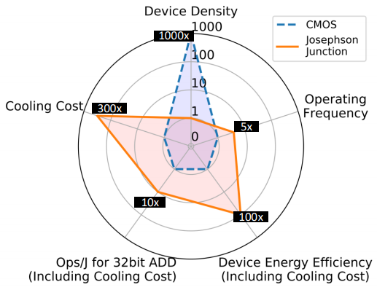
Tailor The Computational Model to Offset Drawbacks of Superconducting?
How to trade off?
(16nm CMOS)
Tannu et al, “A case for superconducting accelerators”, CF 2019
Notes:
To maintain such temperature, a cryogenic cooler is used, and such coolers typically consume 300W power for every 1W dissipated at 4K. Although cooling overhead seems significant, the low switching energy of JJ can still enable devices that have 100x lower energy consumption over CMOS even after accounting for cooling energy overhead.
For existing process technology with 248nm feature size, JJ-device density lags by 1000x as compared to CMOS.
JJ based logic requires more devices per gate as compared to CMOS. The higher device complexity results from limited output driving capacity of JJs. For example, standard CMOS gates have fan-out of four, whereas, JJ based logic gates can drive at most one output without requiring extra output drivers. These output drivers are known as Josephson transmission lines (JTLs) and costs 2-JJ devices per JTL exacerbating the density problem.

Slide 4
Trade off Area for Time: Race Logic
Encode information on time it takes for a transition to appear
Only a single wire is required per variable
Max time slots pre-configured
End of an epoch is when 1 → 0 is allowed
But information in SC logic is encoded in pulses
Madhavan et al, “Race Logic: A Hardware Acceleration for Dynamic Programming Algorithms”, ISCA 2014
G. Tzimpragos et al, “A Computational Temporal Logic for Superconducting Accelerators”, ASPLOS 2020

Slide 5
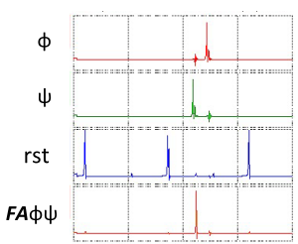
Superconducting Race Logic: Different Gates that Maintain State
First arrival: first incoming pulse causes an output pulse
Picosecond-duration millivolt pulses
RL in superconducting has demonstrated orders of
magnitude higher performance

Slide 6
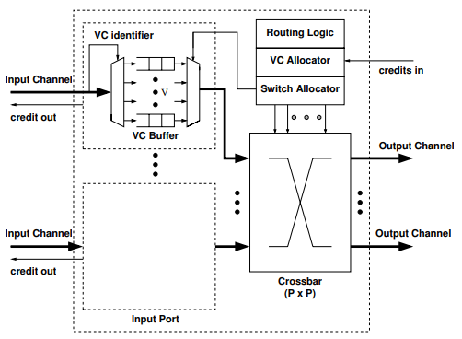
How Can We Design a NoC for Superconducting Race Logic?
Operations in a “typical” VC NoC router do not map in a straightforward manner to RL
Mullins et al, “The Design and Implementation of a Low-Latency On-Chip Network”, ASPDAC 2006

Slide 7
SRNoC: A Race Logic NoC

Slide 8
SRNoC Overview
Inspired by RotorNet: Multiple parallel routers with a fixed schedule
Each source knows when to send a packet based on the packet’s destination
Due to low device density, we proceed with only one 4x4 router and full connectivity with endpoints
Schedule
Router
Endpoint
…
…
Schedule
Router
Endpoint
Mellete et al, “RotorNet: A Scalable, Low-complexity, Optical Datacenter Network”, SIGCOMM 2017
Notes:
We show full connectivity between routers and endpoints but that’s not a rule. Each router has its own independent schedule. We can have any number of routers.

Slide 9
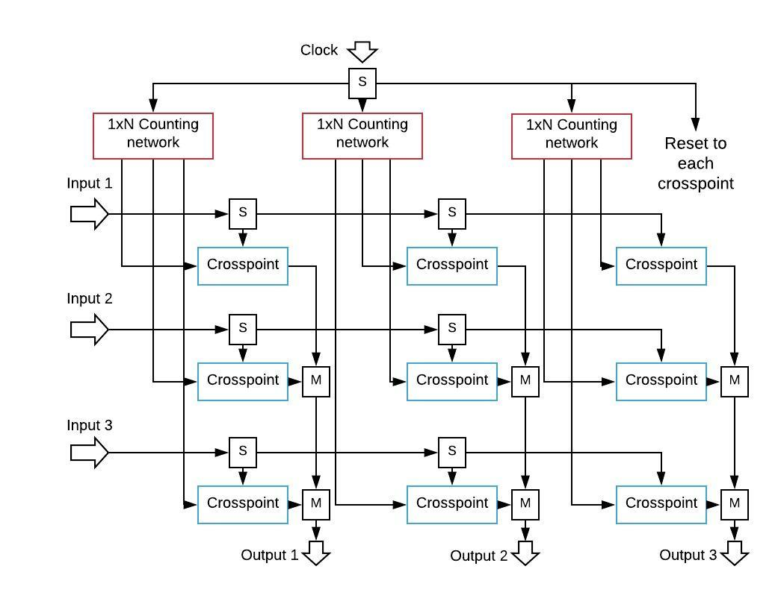
SRNoC Router
Crosspoints in a diagonal are active at any one time
Clock to synchronize
Generate
crosspoint
enables
To connect
the datapath
Now lets look at some components in more detail

Slide 10
Connection Window
Each pulse represents a value and is a packet
Diagram below from the perspective of one router input
Connection window. Input I to output J
RL value
0
1
2
3
4
5
Pulse enters router
Departs in the same
RL value slot
i.e., value is preserved

Slide 11
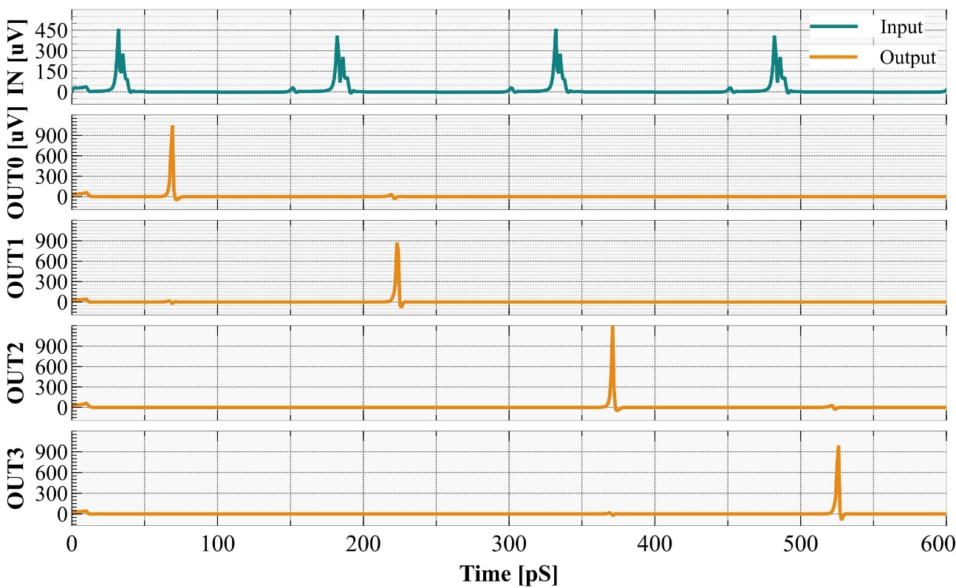
SRNoC Counting Network
Distributes a pulse round-robin among outputs

Slide 12
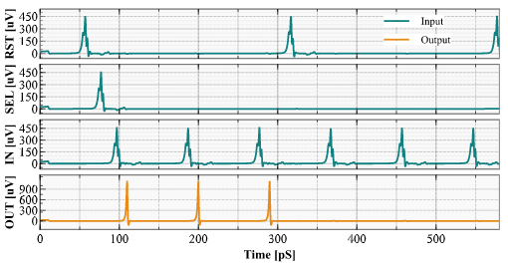
SRNoC Crosspoint
Non-destructive read out (NDRO) cell has two states: connected and unconnected

Slide 13
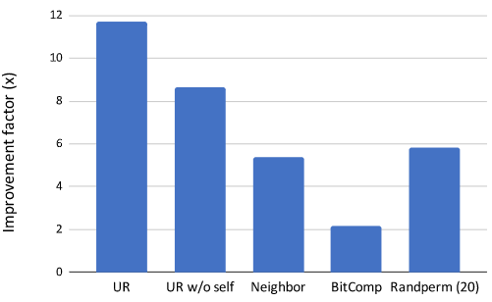
Results Teaser
Due to its fixed schedule, SRNoC performs better with load balanced traffic
Due to its lower area, SRNoC shows improvement
Traffic patterns
Unit: Throughput per port per area (JJ)
Compared to 4x4 40GHz 160 Gb/s binary crossbar
S. Yorozu, et al, “A 40 GHz clock 160 Gb/s 4/spl times/4 switch circuit using single flux quantum technology for high-speed packet switching systems” HPSR, 2004

Slide 14
More In Our Paper
Division of time to preserve race logic values
The counting network’s delay and variability affects the time division
Packets can be composed of multiple pulses
More results: performance, area, power
Latency versus throughput tradeoff
And more!

Slide 15
Acknowledgments
Funded by the army research office (ARO)

Slide 16
Questions?

Slide 17
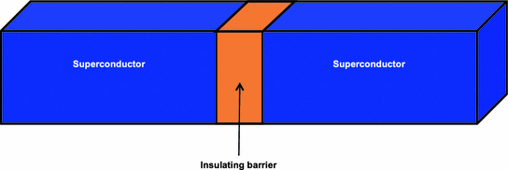
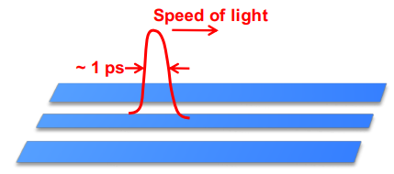
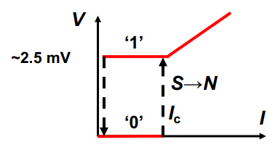
Background: Josephson Junction
Josephson effect: current flowing indefinitely without voltage
Josephson junction: Electrons pass through barrier up to a critical current. Then resistive
Superconducting to resistive state produces a pulse to the output
Information is encoded in normal and superconducting states
Superconductor
Superconductor
Insulating barrier
Johnson, “Superconducting Microelectronics for Next-Generation Computing”, 2018 MIT R&D conference
Khanna, “Rapid Single Quantum Flux (RSFQ) Logic”, Springer Integrated Nanophotonics 2016
Notes:
Critical current in JJs is configurable. SFQ circuits current to about 0.7 times the critical current.
Ultrafast, ~ 1 ps S → N switching by current I > Ic – Slow, ~ 1 ns N → S switching back – ~100 person effort at IBM from 1970 to 1982 – No path identified to outperform transistors.
SFQ comes with a different set of active (JJs) and passive (inductors) components and interconnection structures (Josephson Transmission Lines and Passive Transmission Lines) than CMOS.
JJs are capable of ultrafast (as low as 1ps), low-energy (to the order of 10⁻¹⁹ J) switching by exploiting the Josephson effect: electron pairs tunnel through the barrier without any resistance up to a critical current. At the critical threshold, a JJ switches from its superconducting state to a resistive one and exhibits an electronic “kickback” in the form of magnetic quantum flux transfer – observable as a voltage pulse on the output. To enable stateful circuit operation the unit of fl ux can be temporarily stored in a composite device known as the superconducting quantum interference device (SQUID), which is built as a superconducting loop interrupted by two serial JJs and is common to many superconducting circuits.
A Josephson junction is made by sandwiching a thin layer of a nonsuperconducting material between two layers of superconducting material. Josephson predicted that electrons could "tunnel" right through the nonsuperconducting barrier from one superconductor to another.
Information is stored as a magnetic flux (absence or presence). Josephson effect: current flowing indefinitely long with no voltage.
In traditional SFQ circuits, Josephson Transmission Lines (JTLs) are commonly used for the interconnection of logic cells over short distances. More specifi cally, a JTL is a serial array of superconducting SQUIDs and operates in the following way. Because magnetic fl ux cannot be absorbed or dissipated by a superconducting circuit, an incident flux quantum is only allowed to pass along the JTL, and does so by switching each JJ in turn.

Slide 18
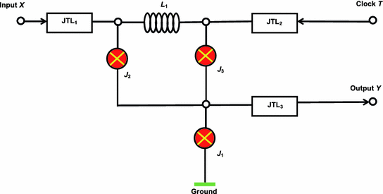
Background: Josephson Junction to Compute
JJ in a superconducting loop allows switching
Inverter:
Inverts direction
Produces pulse
and resets the circuit
Johnson, “Superconducting Microelectronics for Next-Generation Computing”, 2018 MIT R&D conference
Khanna, “Rapid Single Quantum Flux (RSFQ) Logic”, Springer Integrated Nanophotonics 2016
Notes:
Suppose, in the beginning, the circuit is in the 0 binary state. In this condition, a large current is flowing through junction J ₂ while the current across J ₃ is very small. If there is no input signal X, the succeeding clock pulse activates the RFSQ pulse in J ₁, not in J ₃. That’s because the low current in J3 is not enough with the clock pulse to reach critical current but the current from J2 flows to ground through J1 so combined with the clock pulse it’s enough to switch. Appearance of this pulse at the output implies that an input signal ‘0’ provides output signal ‘1’. Arrival of the input signal X will cause switching of the SQUID into state ‘1’. In this state, the current in J ₃ will be high. The following clock pulse will activate an RSFQ pulse across J ₃, not J ₁. Consequently, the circuit will be reset. It will not yield any output pulse implying that input signal ‘1’ produces output signal ‘0’.
Therefore, a single switching of the Josephson junction into the resistive state corresponds to the transmission of a SFQ pulse through the junction.
Flux in a superconducting loop is quantized
Critical current in JJs is configurable. SFQ circuits current to about 0.7 times the critical current.
Pulses have lossless data transmission.
Ultrafast, ~ 1 ps S → N switching by current I > Ic – Slow, ~ 1 ns N → S switching back – ~100 person effort at IBM from 1970 to 1982 – No path identified to outperform transistors.
Ultralow switching energy of ~10-19 J
SFQ comes with a different set of active (JJs) and passive (inductors) components and interconnection structures (Josephson Transmission Lines and Passive Transmission Lines) than CMOS.
JJs are capable of ultrafast (as low as 1ps), low-energy (to the order of 10⁻¹⁹ J) switching by exploiting the Josephson effect: electron pairs tunnel through the barrier without any resistance up to a critical current. At the critical threshold, a JJ switches from its superconducting state to a resistive one and exhibits an electronic “kickback” in the form of magnetic quantum flux transfer – observable as a voltage pulse on the output. To enable stateful circuit operation the unit of fl ux can be temporarily stored in a composite device known as the superconducting quantum interference device (SQUID), which is built as a superconducting loop interrupted by two serial JJs and is common to many superconducting circuits.
A Josephson junction is made by sandwiching a thin layer of a nonsuperconducting material between two layers of superconducting material. Josephson predicted that electrons could "tunnel" right through the nonsuperconducting barrier from one superconductor to another.
Information is stored as a magnetic flux (absence or presence). Josephson effect: current flowing indefinitely long with no voltage.
In traditional SFQ circuits, Josephson Transmission Lines (JTLs) are commonly used for the interconnection of logic cells over short distances. More specifi cally, a JTL is a serial array of superconducting SQUIDs and operates in the following way. Because magnetic fl ux cannot be absorbed or dissipated by a superconducting circuit, an incident flux quantum is only allowed to pass along the JTL, and does so by switching each JJ in turn.

Slide 19
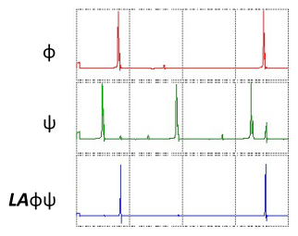
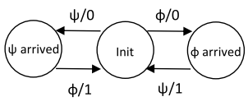
Superconducting Race Logic: Primitives Have to Maintain State
Last arrival: last incoming pulse causes an output pulse
Notes:
For the implementation of the LastArrival gate, a C-element is used – Figure 3 (iv). A C-element has two input ports and consists of two SQUIDs. In the circuit’s initial state, no persistent superconducting current is present in the quantizing loops. When an input arrives, the corresponding junction gets triggered but the generated pulse is not suffi cient to trigger an output pulse. When the second input pulse arrives, the total current exceeds the threshold of criticality, an output pulse gets emitted, and the element returns to its initial state. The order of input pulse arrivals does not matter.

