Slide 1


Modeling of Novel Transistors, Manufacturing Technologies, and Architectures to Preserve Digital Computing Performance Scaling
George Michelogiannakis,
David Donofrio, John Shalf
Lawrence Berkeley National Laboratory

Slide 2
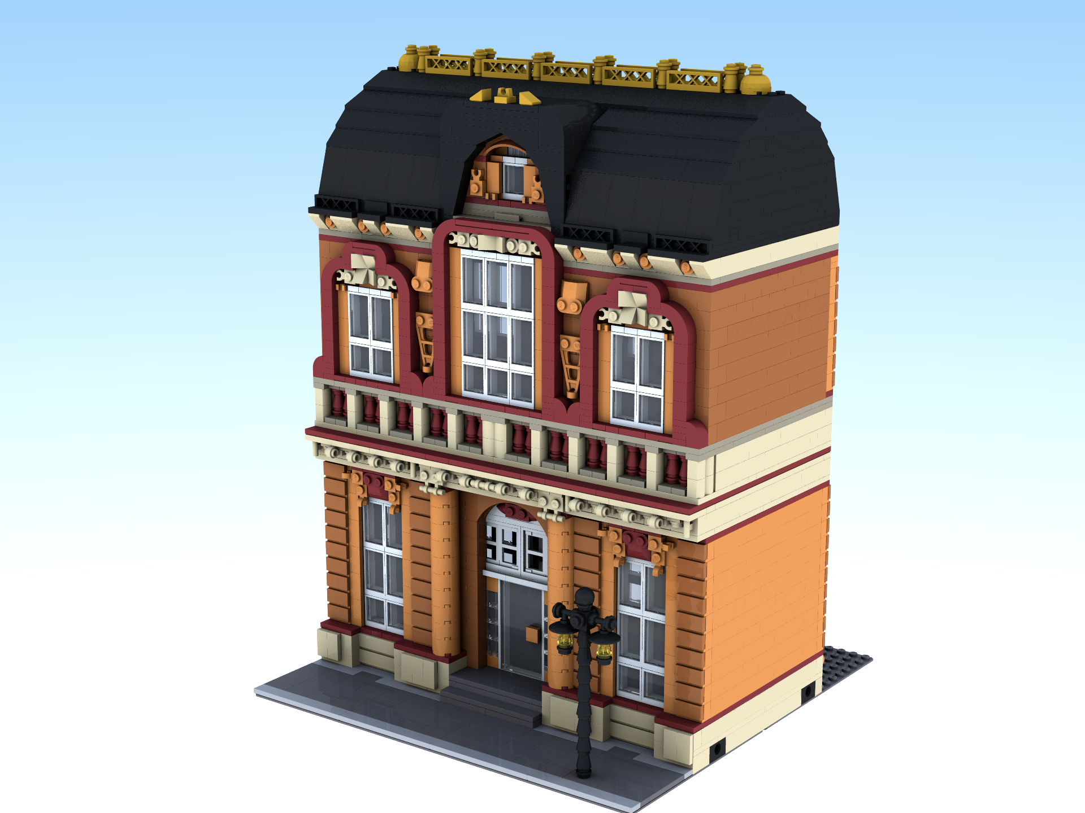
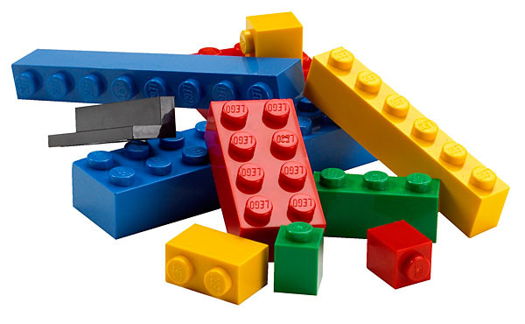

I’m an Architect
Architects use building blocks to come up with clever designs
Any building block we can’t use in a large design we do not know how useful it is, or how to even use it
New piece, can we use it?

Slide 3
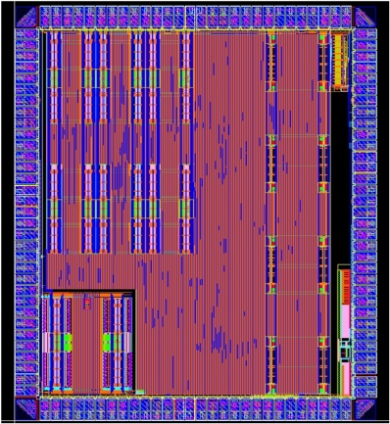
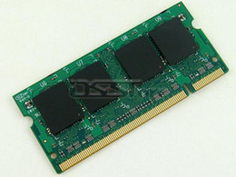
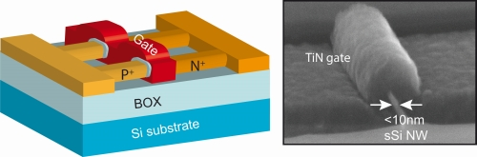
Candidate Technologies To Preserve Moore’s Law Scaling
Emerging transistors
Emerging memories
3D integration
Specialized architectures
Plus others!

Slide 4
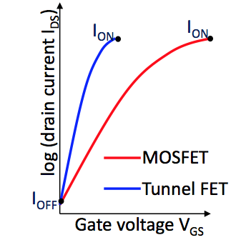
Many Options
Volatile and non-volatile
Emerging
Speed
DRAM
Flash
Capacity

Slide 5

Many Options
Code
Convert to
Hardware
MRAM
Other Functions
Accelerator
Memory
GP CPU

Slide 6
The Goal: Evaluation Framework
Specialization, 3D stacking, memories
Performance
Power
Other (e.g., faults)
Architectural and system behavioral models
Models and characteristics of devices
Algorithms and kernels
Notes:
Models and characteristics of devices: voltage, power, performance, reliability, fanin etc. They are compact models.
The models and tools we have have served us well in the last 5-10 years but we need to update them with new models for emerging devices.

Slide 7

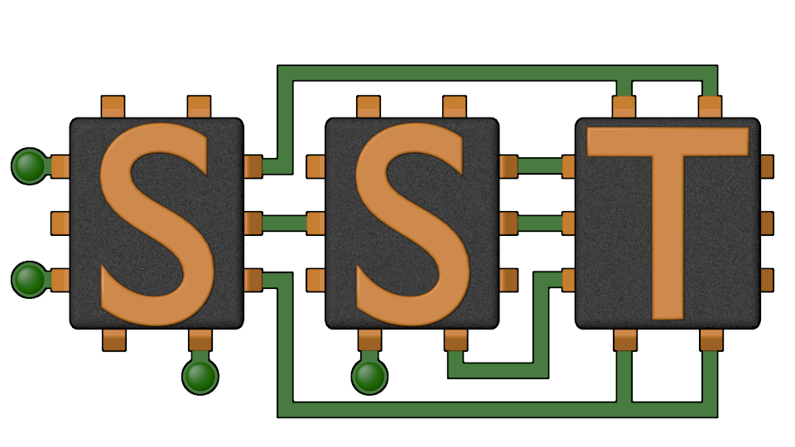
Modeling New Devices
SPICE models exist for TFETs, NCFETs, CNFETs
  (Non-exhaustive list)
This is not sufficient for architectural exploration
  Need energy per bit, delays, error rates, etc.

Slide 8
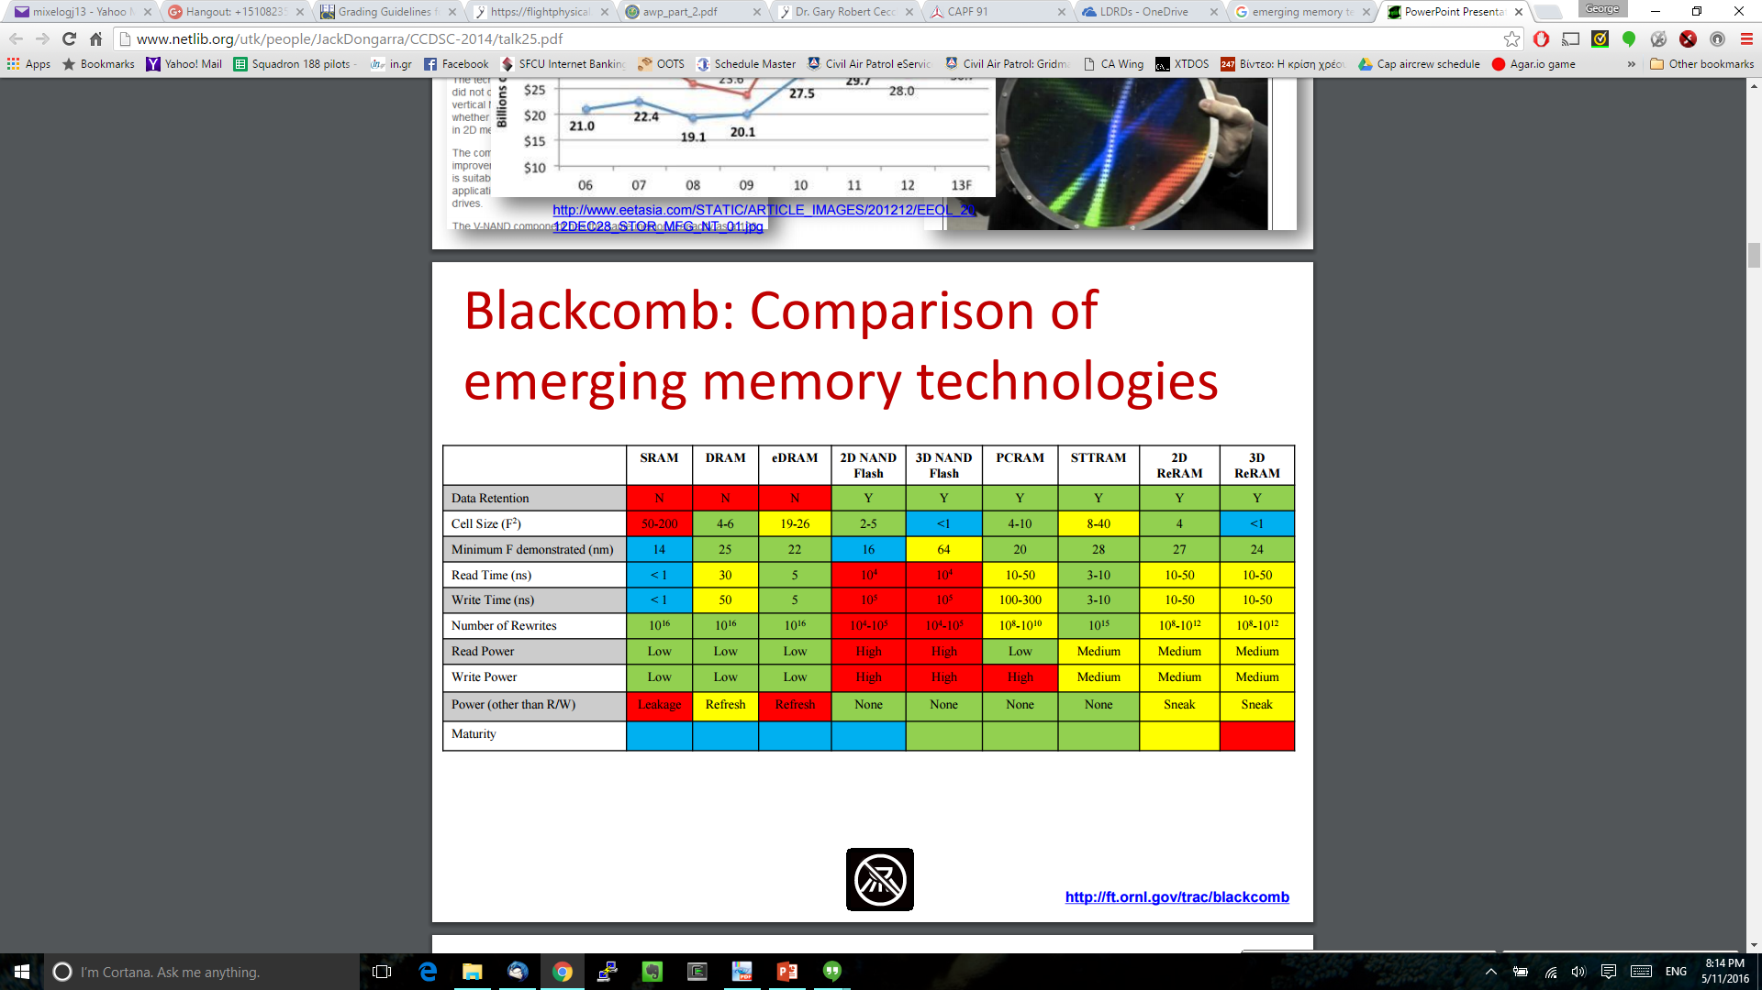
Modeling New Memories
Several parameters for each option
Plus, how to take advantage of non-volatility close to cores
J.S. Vetter and S. Mittal, “Opportunities for Nonvolatile Memory Systems in Extreme-Scale High Performance Computing,” CiSE, 17(2):73-82, 2015.

Slide 9
3D Integration
Different permutations of layers change latencies and energies for communication
Also, VIA technology is crucial
  As well as other challenges like heat density
Would like to make architectural simulators aware of 3D stacking
MRAM
Other Functions
Accelerator
Memory
GP CPU

Slide 10
Architectural Specialization
Explore the specialization spectrum by rapidly modeling architectures specialized to specific functions
  Perhaps with a higher-level programming language
  How will programmers use them?
This combines with other emerging technologies
Fully programmable
Fixed function
Specialization spectrum

Slide 11
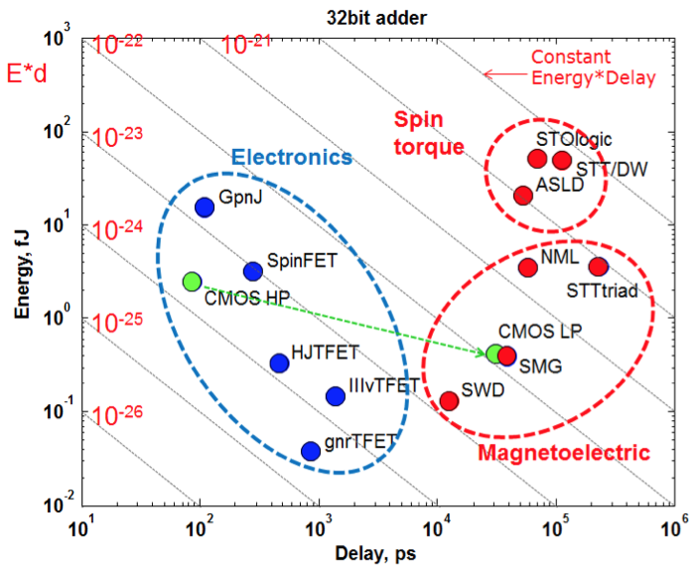
What is the Point of This?
We have to figure out the impact of emerging technologies to system-level metrics
  Are they feasible?
Also how emerging technologies change the architecture and programming
  I.e., how to best make use of them
Nikonov/Young (Intel)

Slide 12
What Infrastructure?
Software simulators with cost models
Or HDL design flow

Slide 13

Questions?
Need to model emerging technologies in the architectural level
Otherwise hard to know the impact and benefit

